Slide 1
CYBER SECURITY TOWARDS DIGITAL INDIA
HACKATON 2019
Presentation on
BIOMETRIC WALLET
PRESENTED BY:
YASHASWINI R
NIVEDA R

Slide 2
Project Objective
As you know the digital wallets can only be used online and via your devices like laptop, smartphone or tablet, so the use of digital wallets are highly dependent of your device. If anyhow you’re unable to reach your smartphone or laptop such as due to battery problem of any other reason, digital wallets are of no use.
Whereas credit and debit cards can be accessed only in their presence.
But in Biometric wallets the transactions and payments can be done without carrying any cards or devices like smartphones or laptops. This is the main reason why biometric wallets can beat digital wallet , credit and debit cards.

Slide 3
Introduction
Google Wallet is one of the most prominent smartphone apps leveraging the power of NFC. All of your credit card data (as well as loyalty and gift cards and all sorts of other data) is stored on Google's servers and not your phone. Wallet works online, too, much like PayPal or other wallet services. Just sign into your password-protected account and you'll complete a purchase in seconds instead of minutes.
But in Biometric wallet we can have payments and transactions just by our finger print and by face recognition without using any other passwords or OTP numbers.

Slide 4
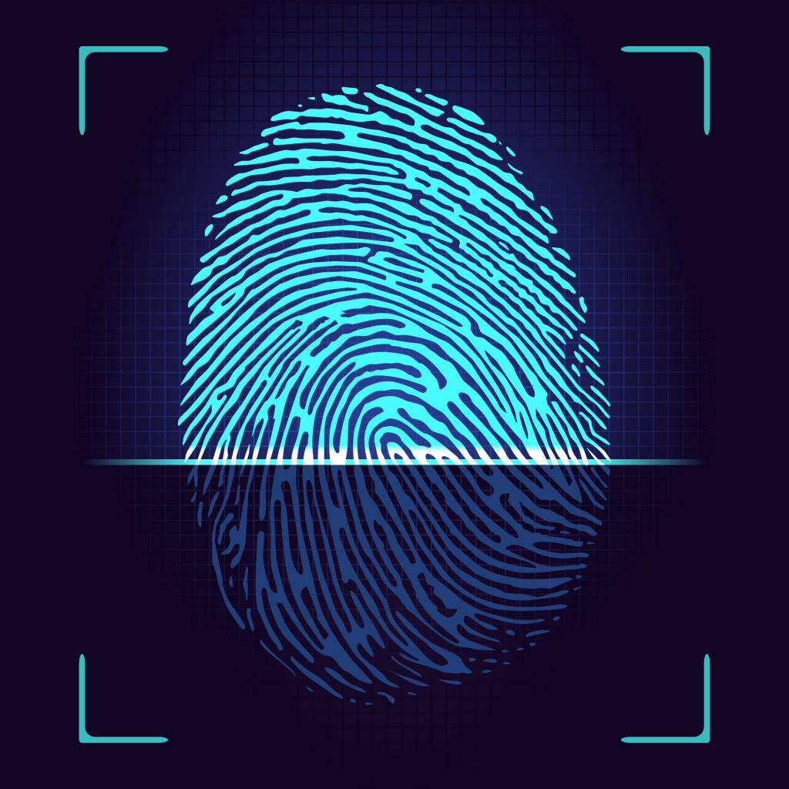
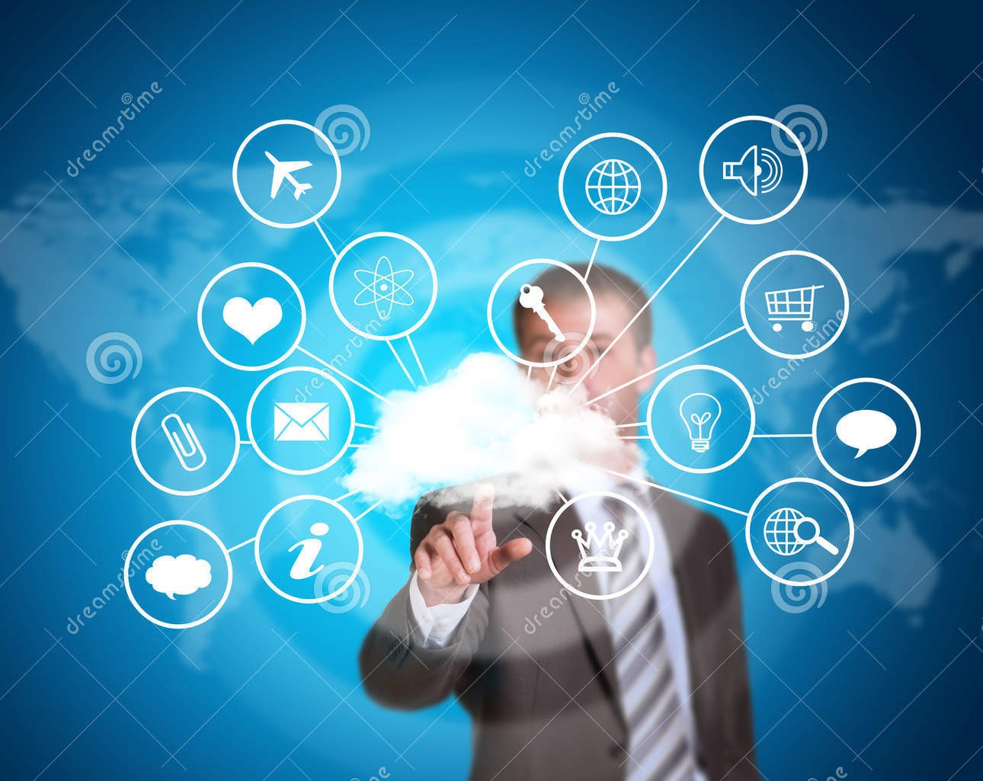
Procedure
Biometric wallet can be used with the help of fingerprint and face recognition.
As soon as we provide fingerprint, a dropdown list of bank accounts or other payments apps account will appear.

Slide 5
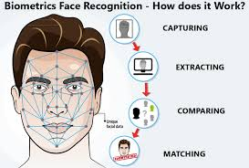
Procedure
Users select their account and continues with the transaction or payments by undergoing face recognition.
By this method Biometric wallet helps you to shop or pay anything cashless ,with or without using any devices like smart phones, laptops or cards.

Slide 6
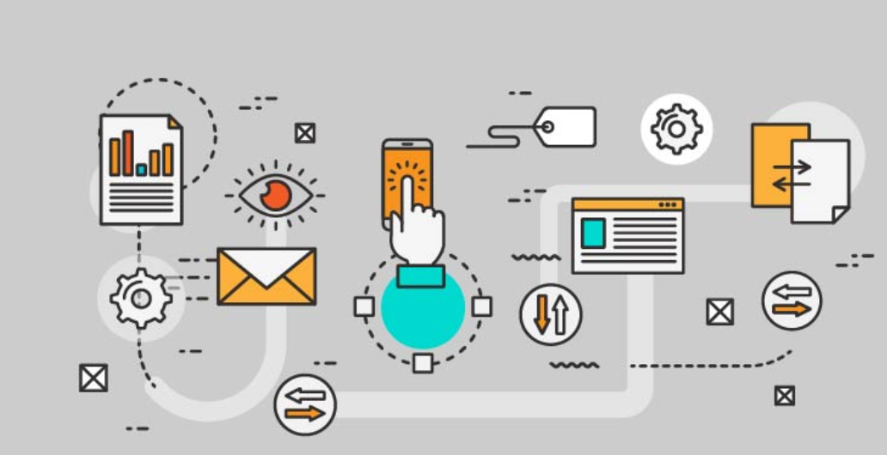
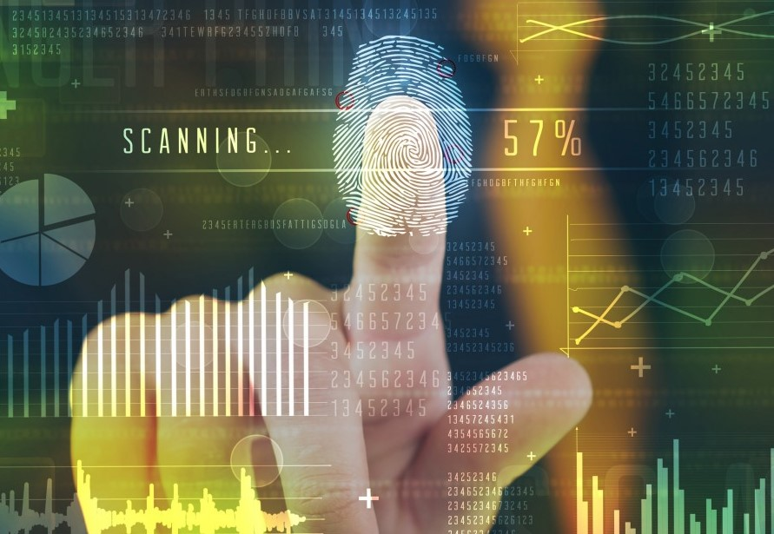
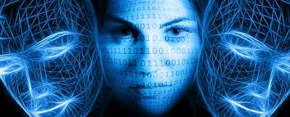
Procedure
How unified payment interface works?
User provides fingerprint.
Dropdown list of accounts is displayed.
User selects the account.
User undergoes face recognition and then continues with payments or transactions.
Mail and message regarding the details of the transactions will be sent to users email account and to the registered number.

Slide 7
Thank You

